Slide 1

Mihaela Gamulin Valentina Gavranić Dajana Jerončić
RP - projekt
Language learning website

Slide 2
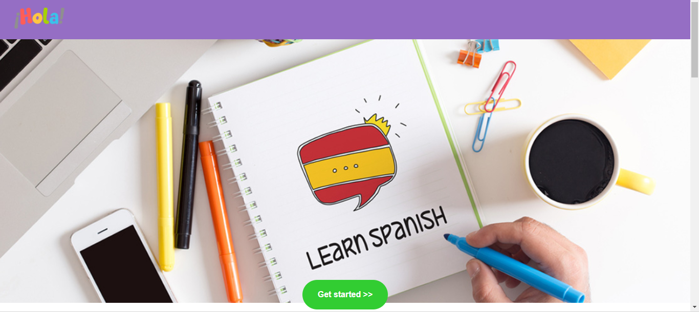
HOLA - Language learning website

Slide 3
Flowchart
Register
Lesson
Quiz
Index
Login
MyLesson
Leaderboard
Profile

Slide 4
BAZA PODATAKA
llUsers
llLesons
llDiscussion
llImage
llSentence

Slide 5
USER - llUsers
id-user (auto increment)
username
email
password_hash
reg_seq
has_reg
score
id_lesson
profile_image
about_me

Slide 6
LESSON - llLessons
id_lesson
title
link (link na prezentaciju)
image
Image_locked

Slide 7
DISCUSSION - llDiscussion
id_discussion
text
id_user
id_lesson
date

Slide 8
IMAGE - llImages
id_image
id_lesson
link
eng
spa

Slide 9
SENTENCES - llSentence
id_sentence
id_lesson
eng
spa
missing
option1
option2
option3
option4
correct

Slide 10

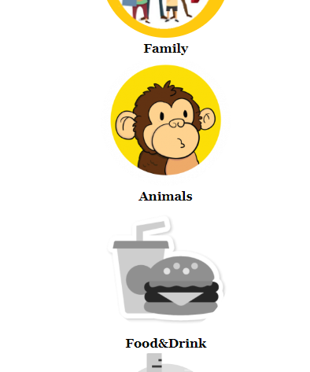
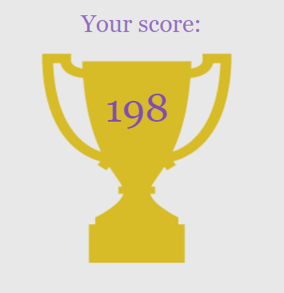
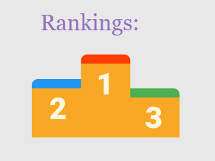
My_lesson
Logout or go to your profile!
Check your score and ranking!
Pass quiz and unlock next level!

Slide 11
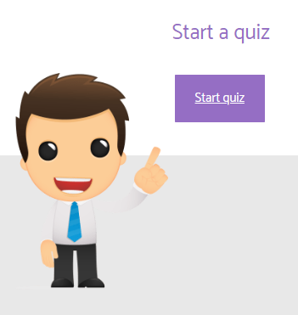
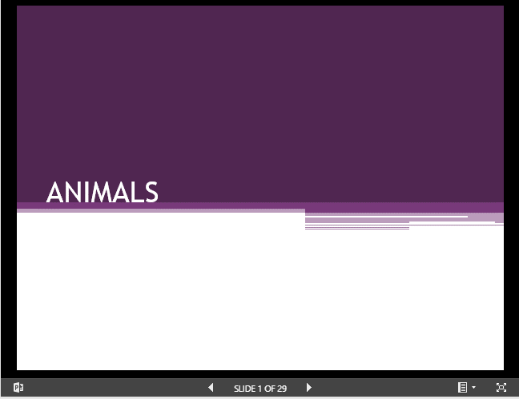
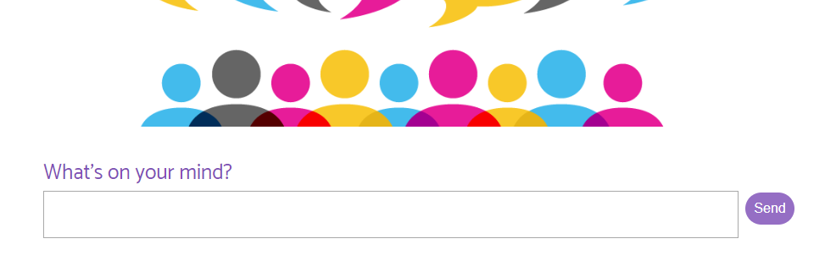
View_lesson
Put your knowledge to the test!
Review lesson slides and learn something new!
Don’t understand something? Just ask!

Slide 12
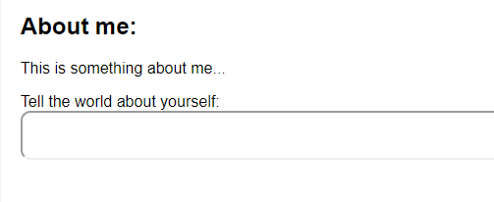
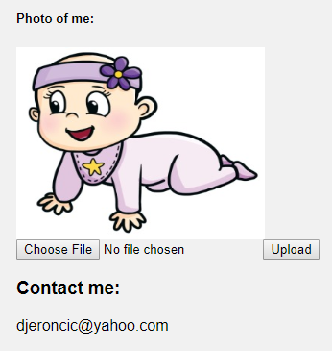
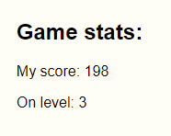
My_profile
Add something about yourself!
Check stats and try to be the best!
Upload profile image or check someone else’s!

Slide 13

... and much much more ...
rp2.studenti.math.hr/~username/HOLA
$$username∈\{vagavra, migamul,dajeron\}$$

